Slide 1

Attack-Defense Cybersecurity Simulation
Integrated Project
Fanshawe College
Professor: Alex Marinesc

Slide 2
Team Members
Jay Patel (1119384)
Vansh Patel (1156898)
Chahakkumar Rupavatiya (1119262)
Madhav Madhav (1118317)
Harjas Lehar (0935464)

Slide 3

AGENDA
Project Overview
Network Architecture
Red Team Attack Path
Blue Team Detection & Monitoring
Blue Team Hardening (Screenshots included)
Recommendations
Lessons Learned
Q&A

Slide 4
Project Overview
The project is a hands-on training where we built a small company network inside a virtualization software.
This project simulates a real-world attack and defense scenario
Red team: Demonstrate how a real-world attacker would attack a network.
Blue team: Detected a red team activities using tools and monitoring systems.

Slide 5
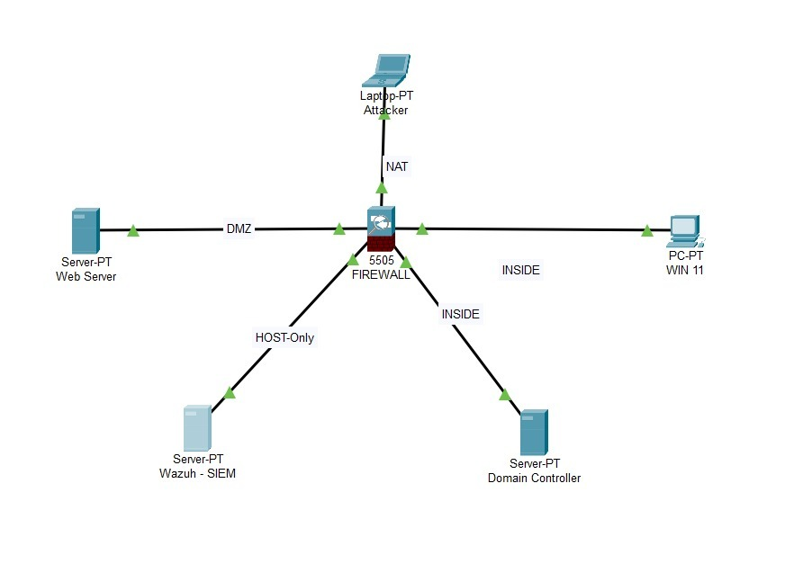
Network Architect
Ubuntu Web Server (DVWA)
Windows 11 Workstation
Windows Server Domain Controller
pfSense Firewall with Snort IDS
Wazuh SIEM Server
Kali Linux Attacker

Slide 6
MITREE ATT&CK
Mapped Techniques Used by Red Team:
T1595: Active Scanning
T1190: Exploit Public-Facing Application
T1110: Brute Force
T1548: Abuse Elevation Control Mechanisms
T1021: Remote Services
T1069: Permission Groups Discovery
T1558: Kerberoasting

Slide 7
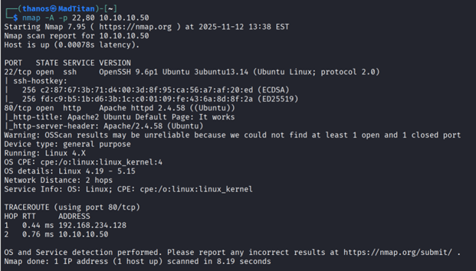
Attack Stage 1: Reconnaissance
Nmap scan was performed on 10.10.10.50.
Open ports discovered:
22 SSH
80 HTTP

Slide 8
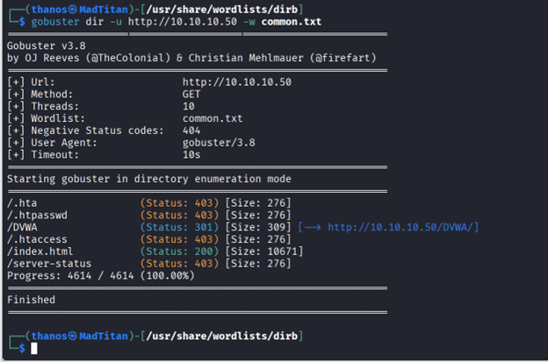
Attack Stage 2 : Enumeration
SSH Enumeration.
Password based authentication confirmed
Web Enumeration.
Apache default page visible -> misconfiguration.
Gobuster discovered /DVWA directory.

Slide 9

Attack Stage 3 : DVWA Exploitation
DVWA login accessed using default credentials.
File Upload module restricted to JPEG/PNG.
BurpSuite used to modify header and bypass restrictions.
Uploaded PHP reverse shell to:/hackable/uploads/exploit.php
Achieved web server shell access.

Slide 10
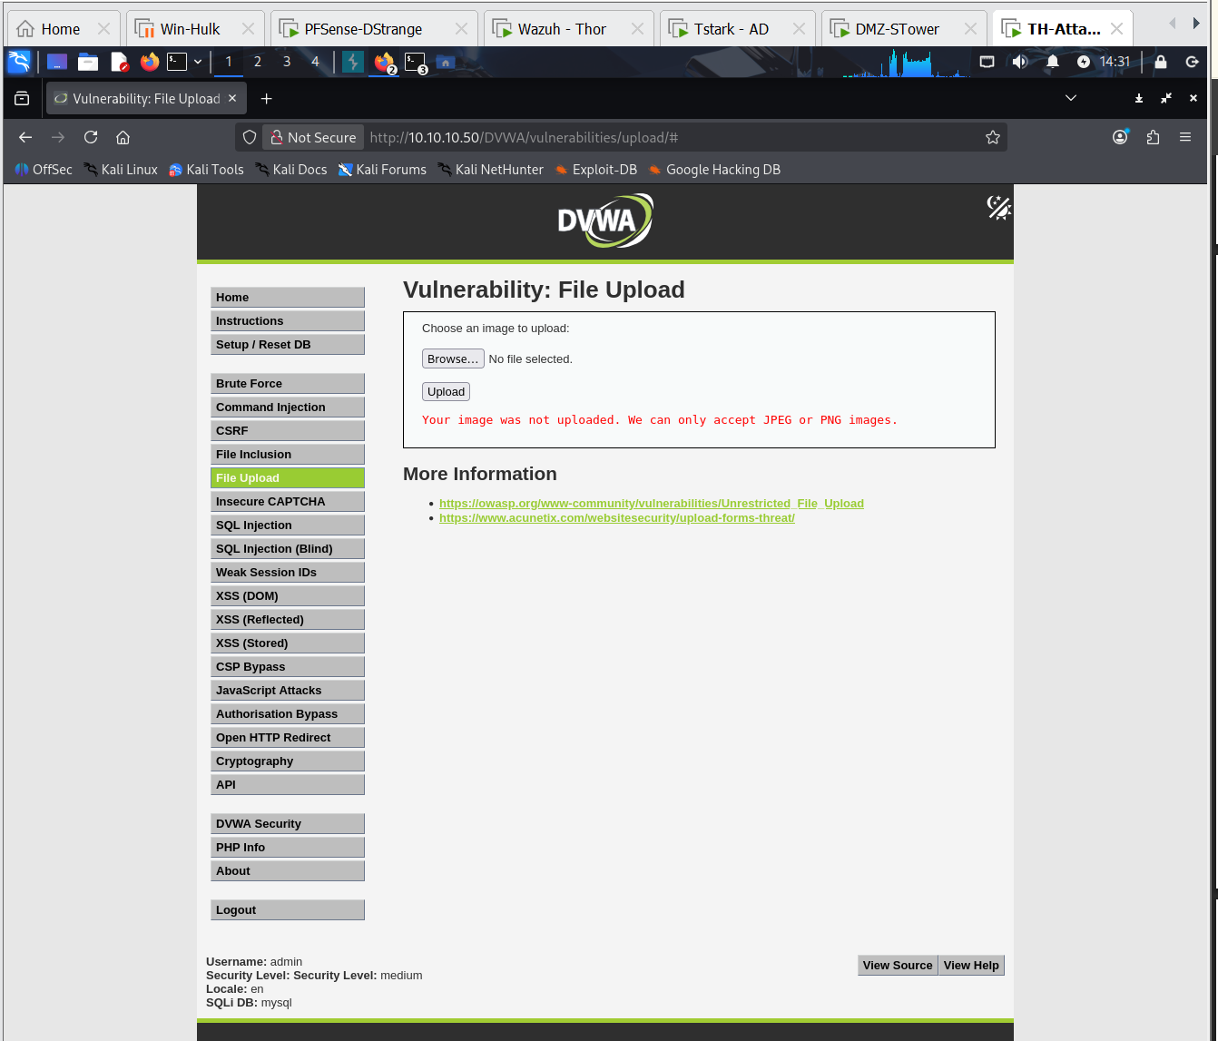
DVWA Exploitation

Slide 11
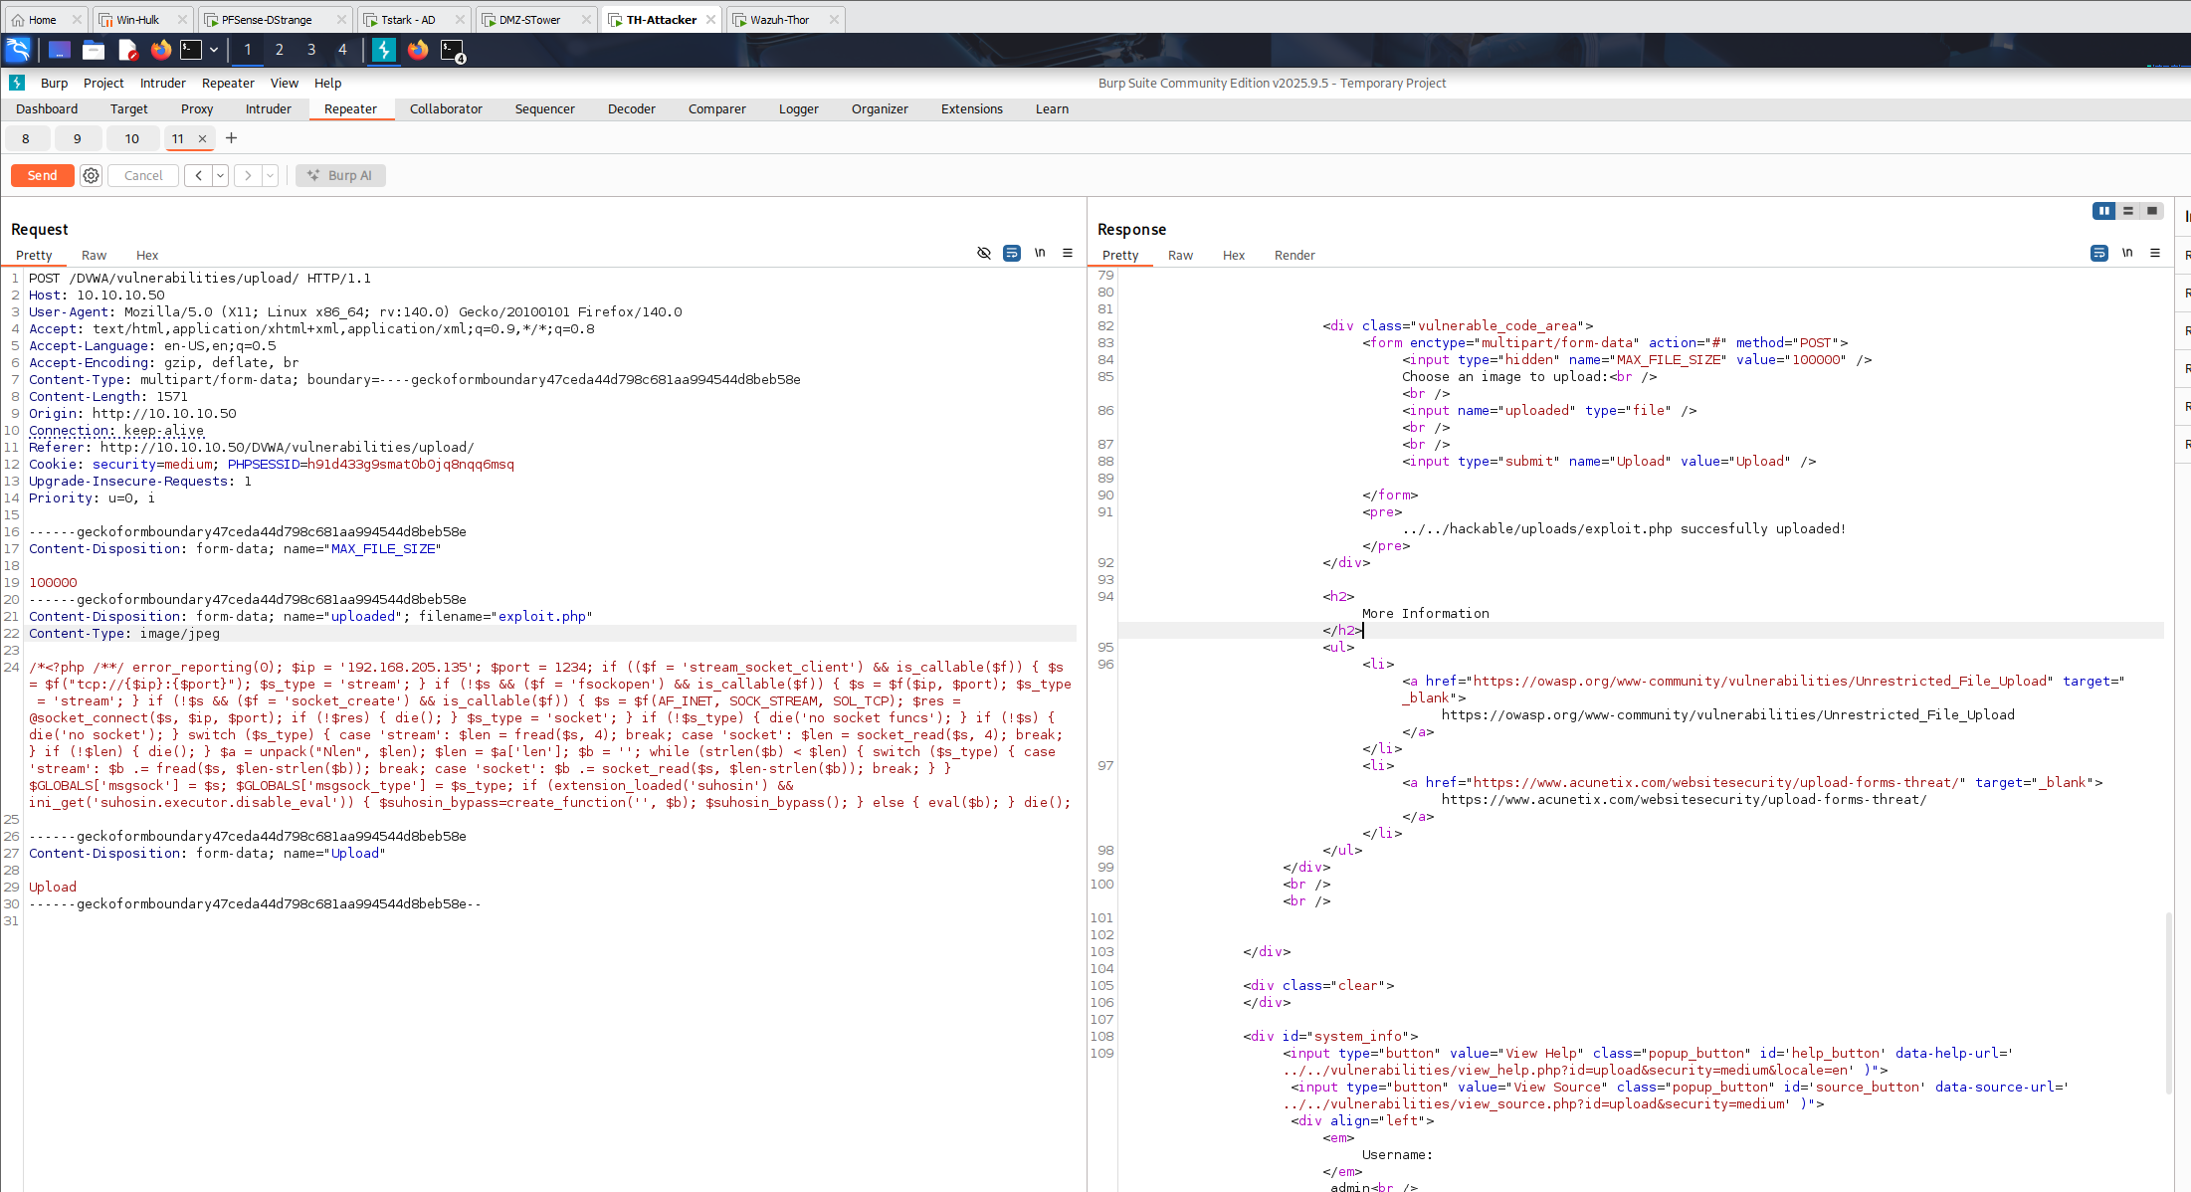
Burpsuite

Slide 12
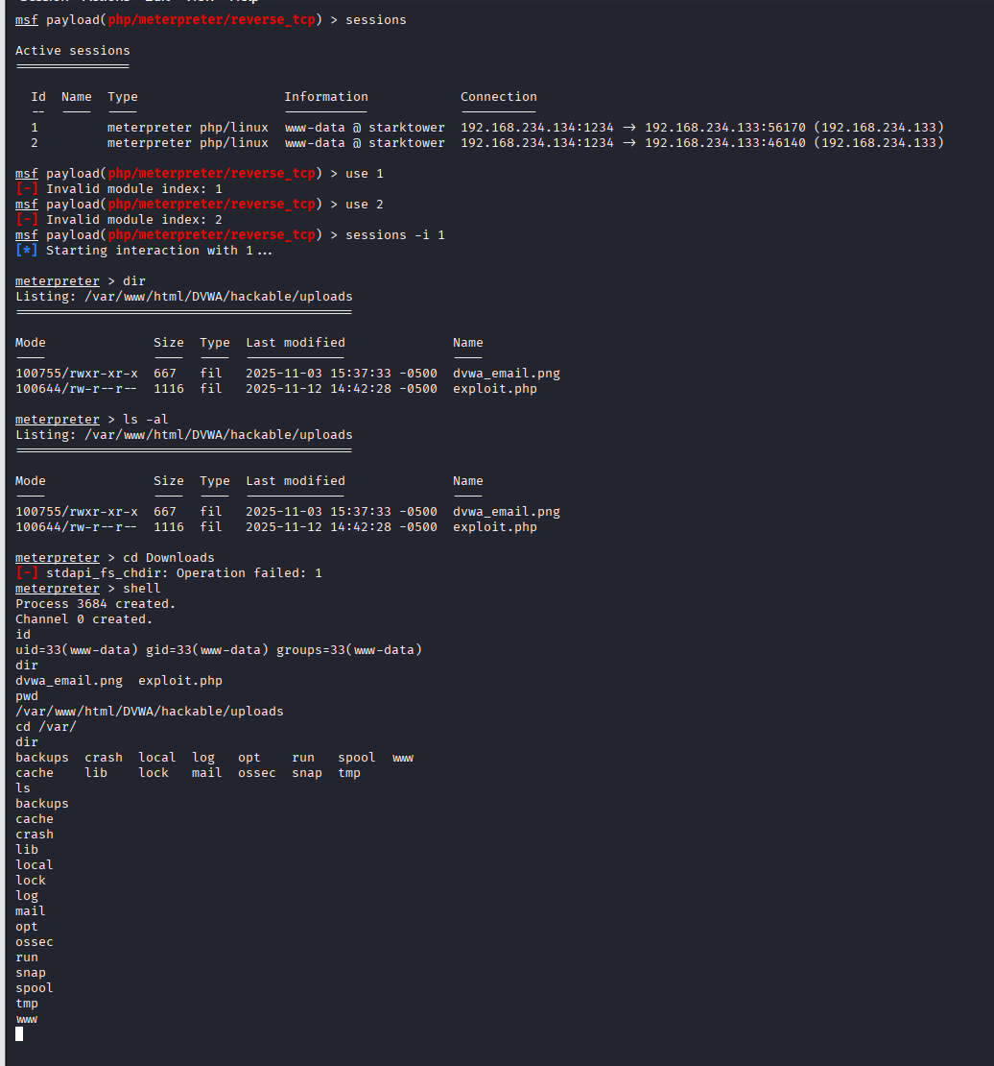
Shell Access

Slide 13

Attack Stage 4 : Privilege Escalation in Linux
Valid username retrieved using /etc/passwd
01
Password spray attack was launched using hydra against found username.
02
Valid credentials found for spidey user.(antman user also had the same password)
03
Sudo check revealed user can run python as root without password.
04
Python command executed -> full root shell obtained.
05

Slide 14
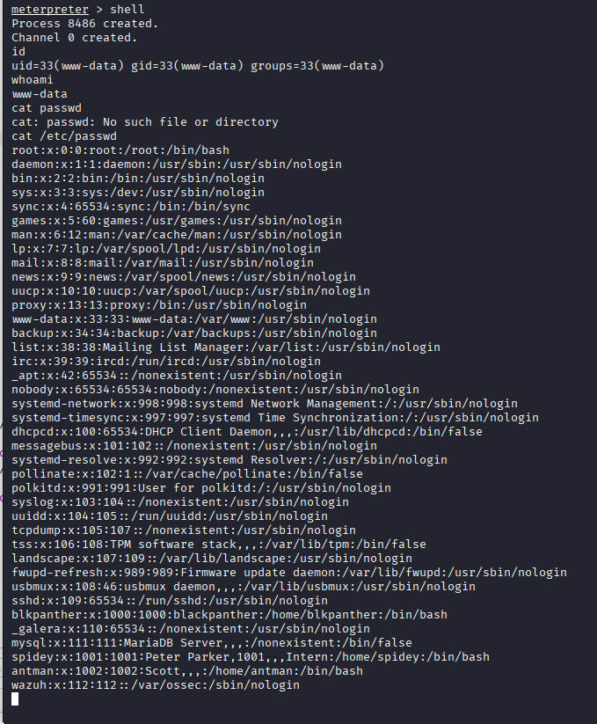
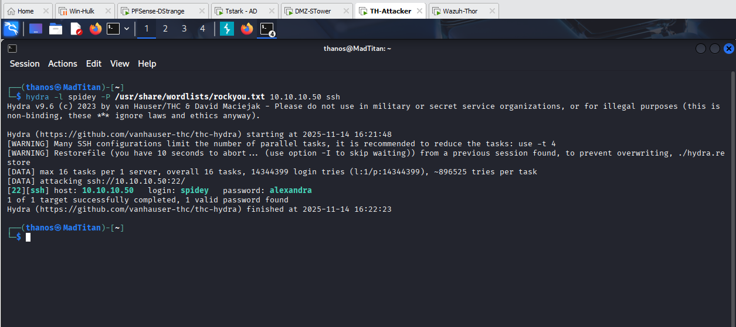
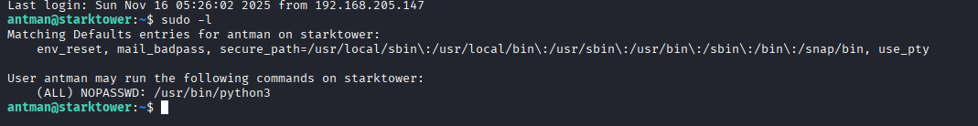
Linux Privilege escalation.

Slide 15
Attack stage 5 : Lateral Movement to Windows
A txt file in linux root directory contain password hint.
A custom wordlist was created using a password hint.
Hydra brute force launched against rdp service using custom wordlist.
Rdp access was established.
Winpeas revealed local admin privileges.
A domain user named hawkeye was added to RDP.

Slide 16
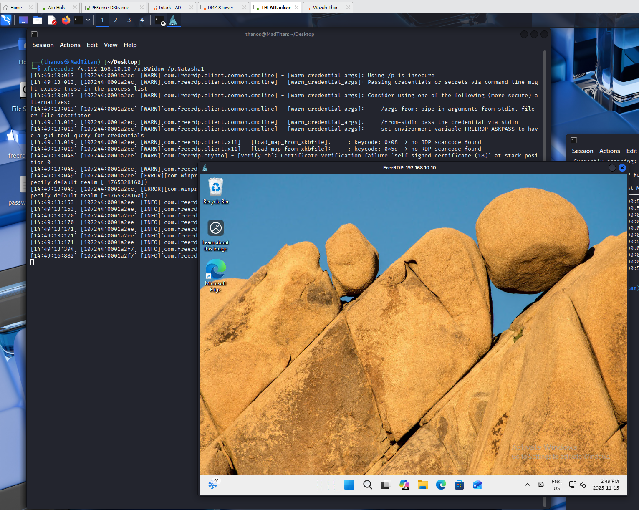
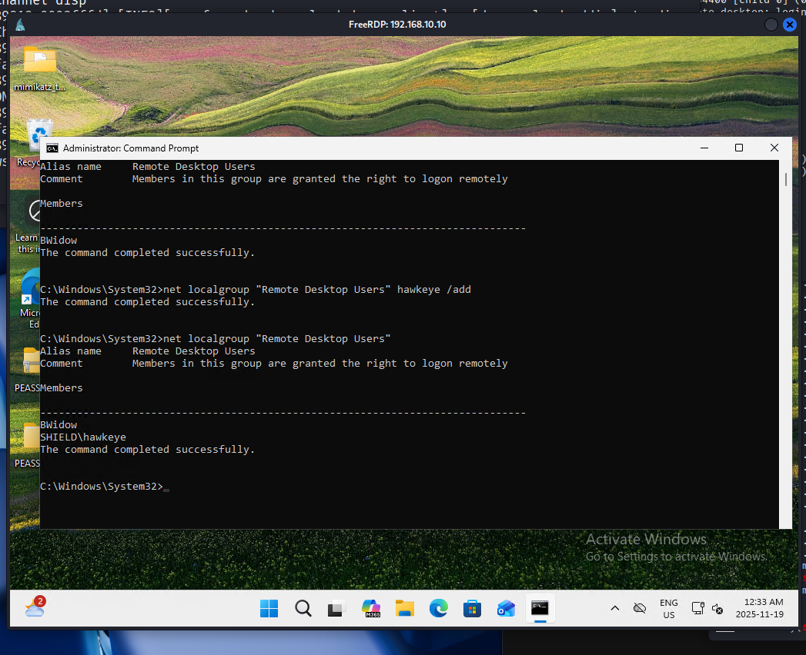
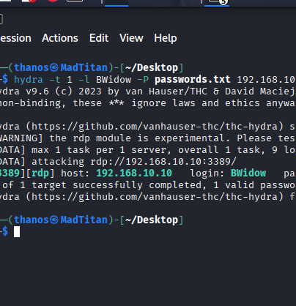
Lateral Movement to Windows

Slide 17

Attack Stage 6 : Domain Compromise
AD data was gathered using sharphound.
Bloodhound revealed svc_backup user as Domain Admin.
Kerberoasting attack was launched on service account.
Using hashcat, captured hash was captured.
Evil-Winrm was too used to log into domain controller, giving full domain admin rights.

Slide 18
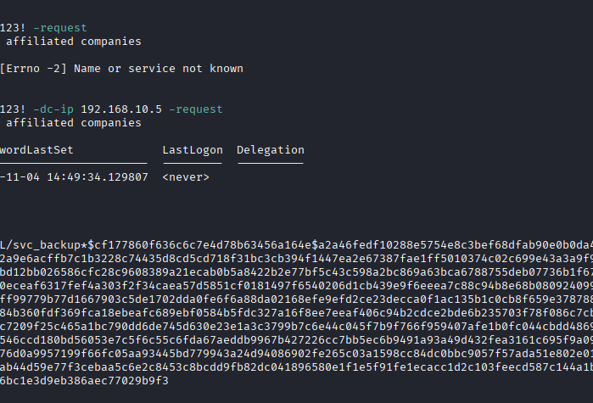
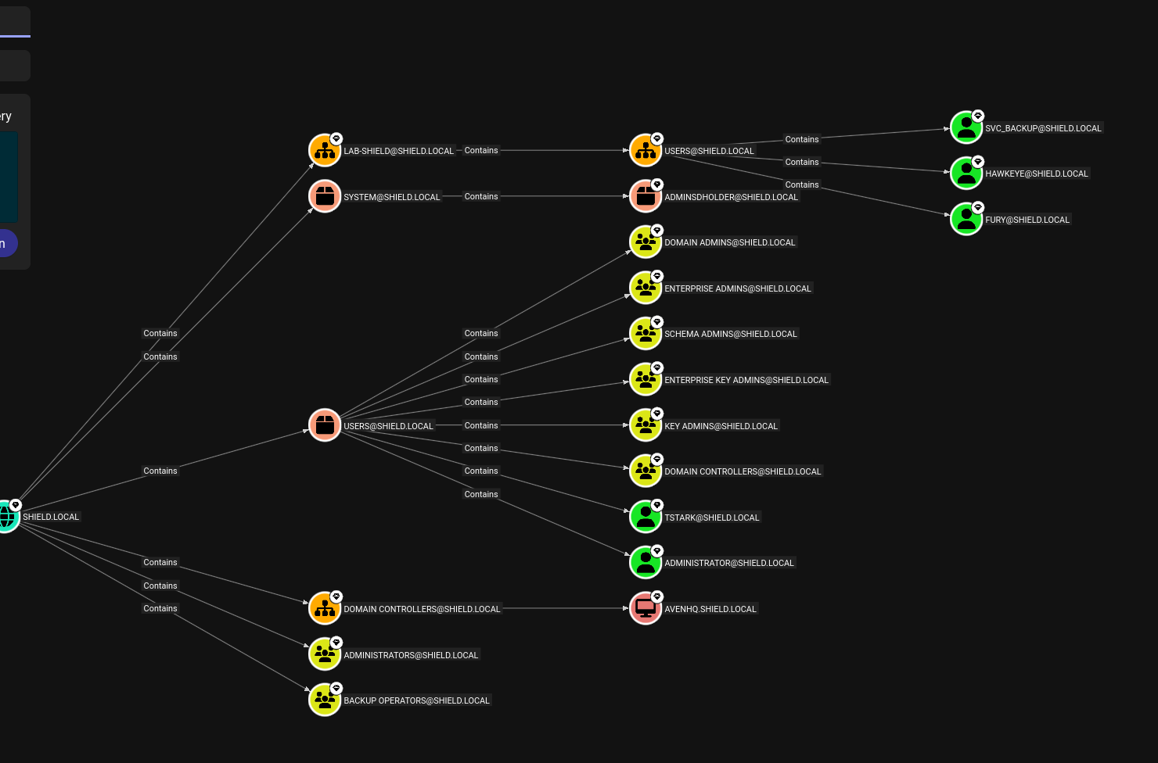
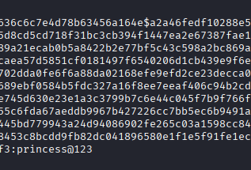
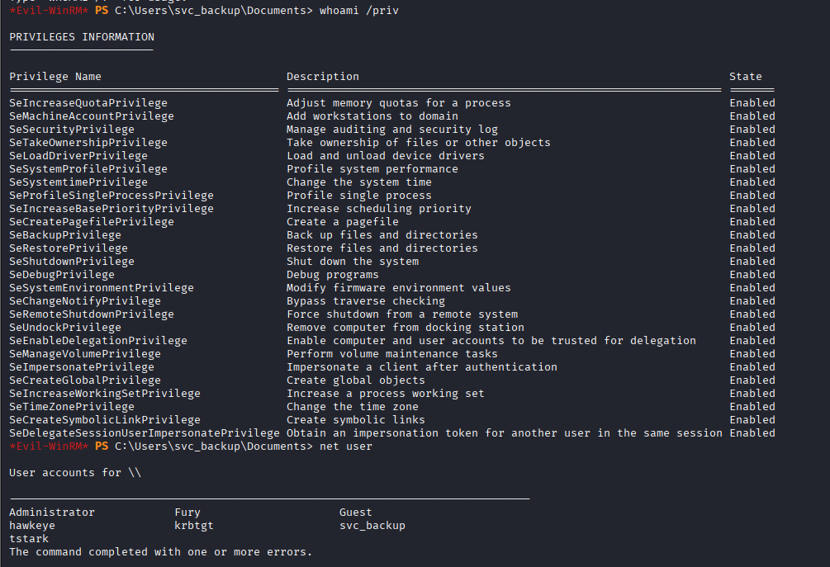
Domain Compromise

Slide 19
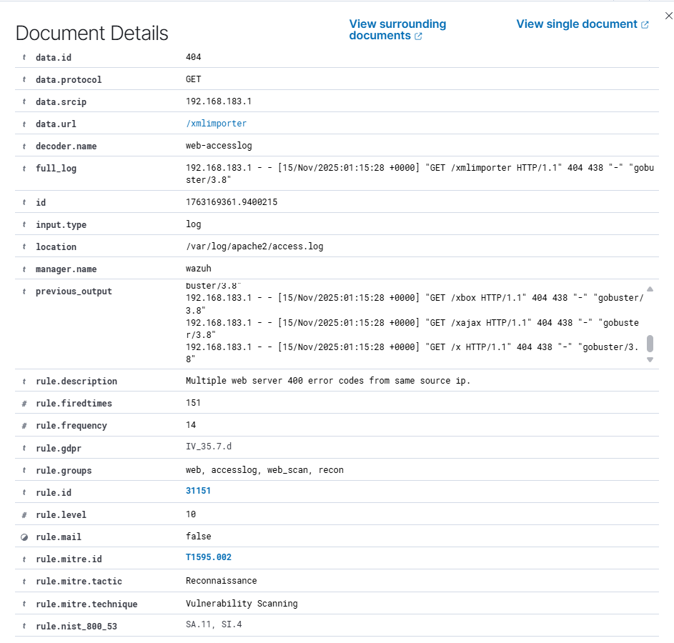
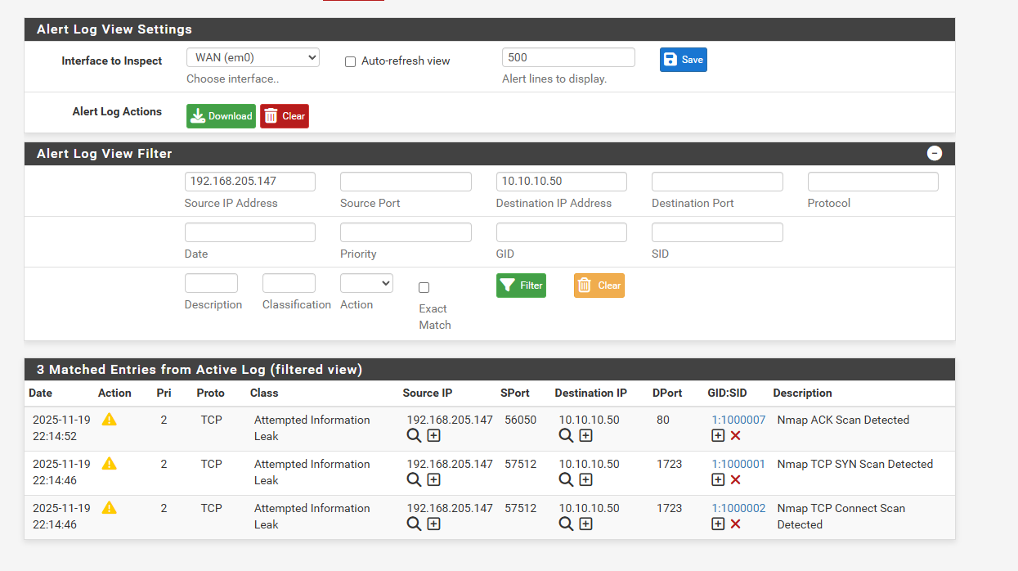
Detection: Recon & Enumeration
Snort Detection:
Nmap port scan flagged as malicious.
Wazuh Detection:
Rapid Get requests from gobuster identified in apache logs.

Slide 20
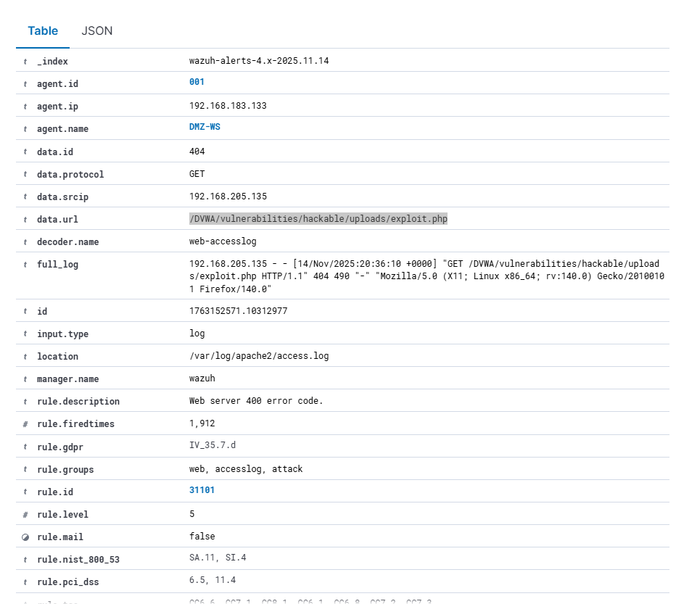
Detection: Exploitation
Wazuh detected file upload to suspicious path: /hackable/uploads/exploit.php
Reverse shell activity was logged.
High-severity alert triggered.

Slide 21
Detection: Lateral Movement
Multiple failed SSH attempts detected as brute force.
Successful RDP logon from unexpected accounts flagged.
WinPeas and defender bypass actions logged on workstation.

Slide 22
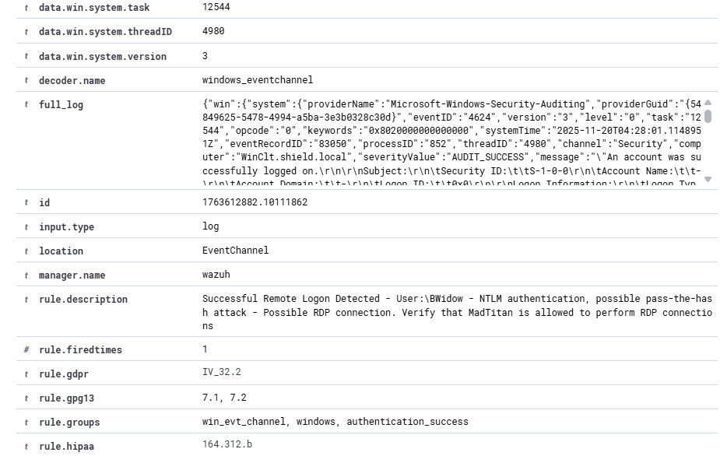
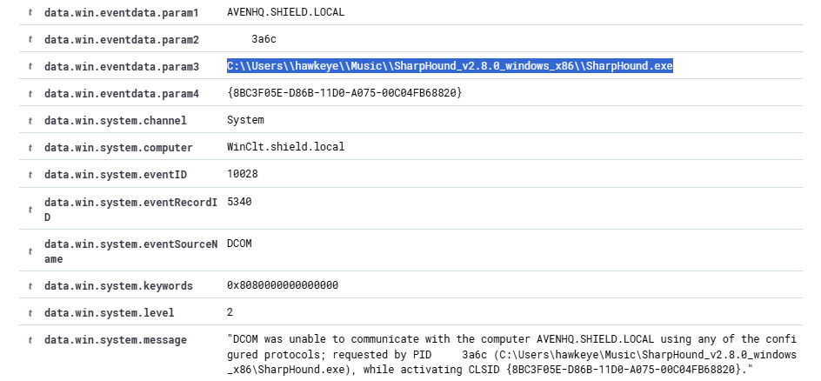
Detection: Lateral Movement

Slide 23
Detection: Privilege Escalation & kerberoasting
Sudo python escalation identified as abnormal behavior.
Kerberos TGT ticket request for svc_backup flagged.
DC login by svc_backup triggered high severity alert.

Slide 24
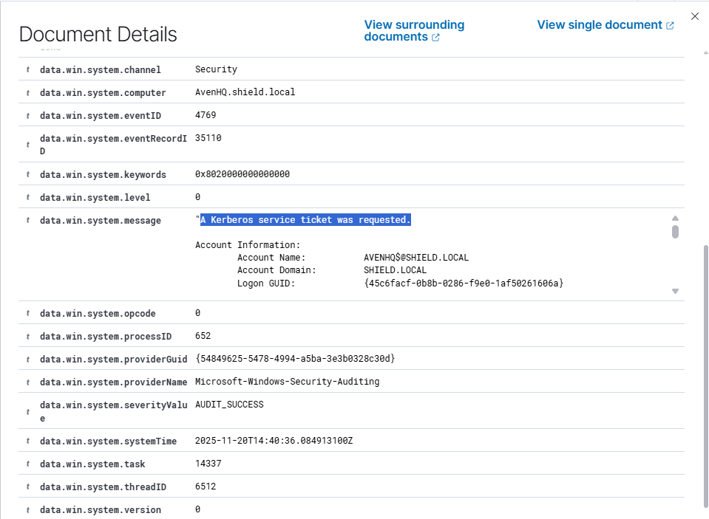
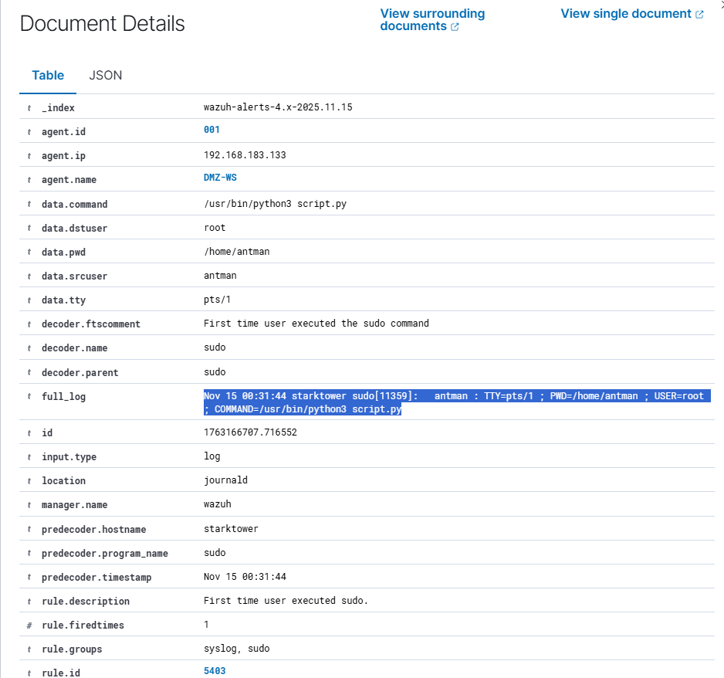
Detection: Privilege Escalation & kerberoasting

Slide 25
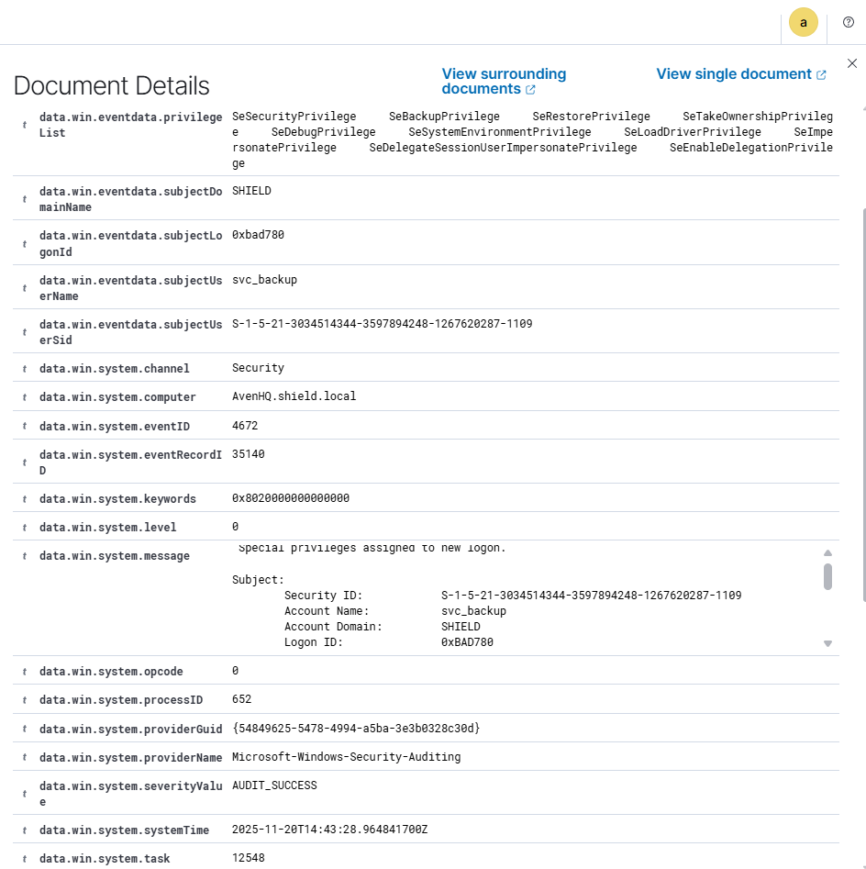
Domain Admin Login

Slide 26
Network hardening
Sanitized firewall rules to restrict external traffic.
Disabled ICMP and unnecessary ports.
SSH restricted to internal trusted hosts only.

Slide 27
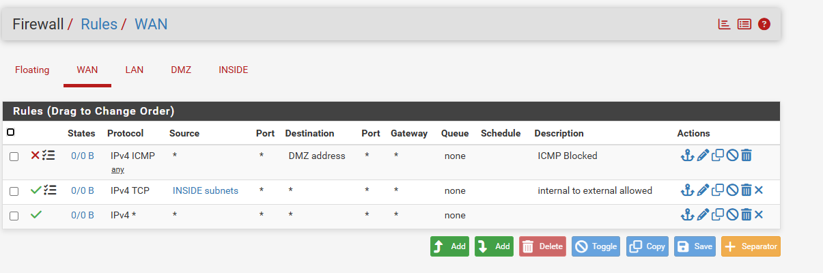
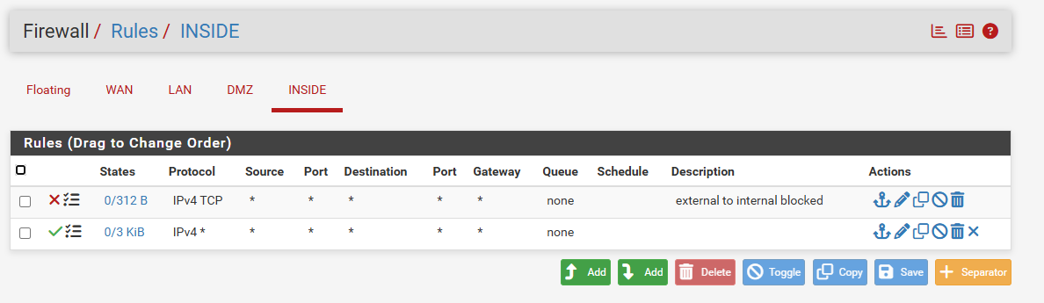
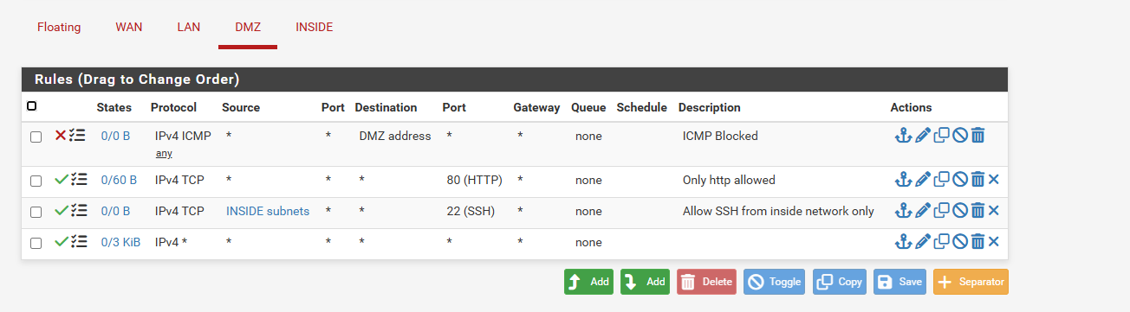
Network hardening

Slide 28
Linux Hardening
Removed DVWA and default Apache pages.
Disabled directory listing and unsafe PHP modules.
Enforced SSH key-based authentication.

Slide 29
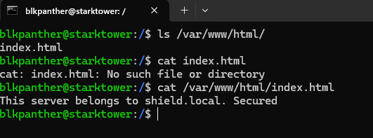
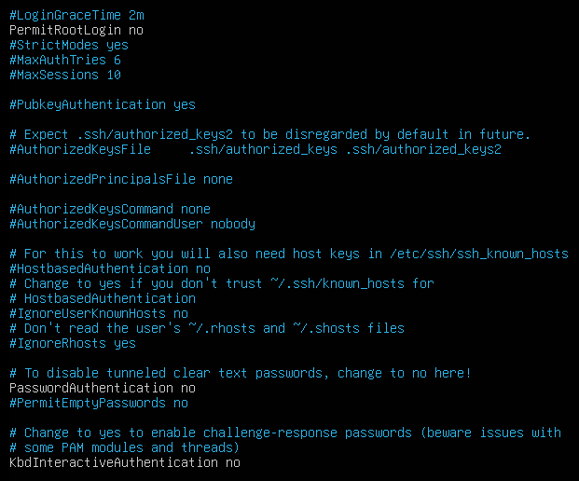
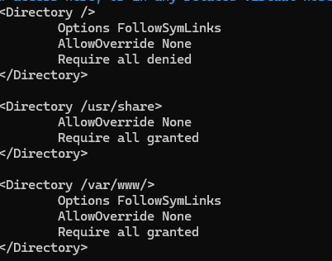
Linux Hardening

Slide 30
Windows Hardening
Removed unauthorized local administrators.
Enabled complex password policies via GPO.
Restricted RDP to authorized privileged groups only.
Implemented LAPS for secure password rotation.

Slide 31
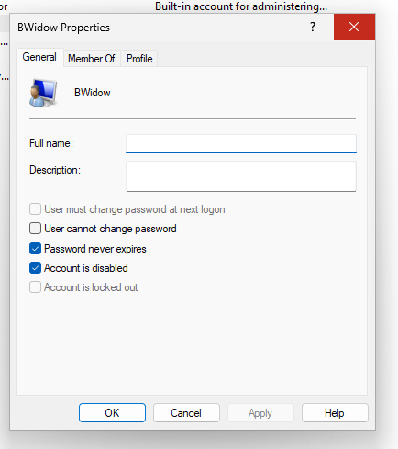
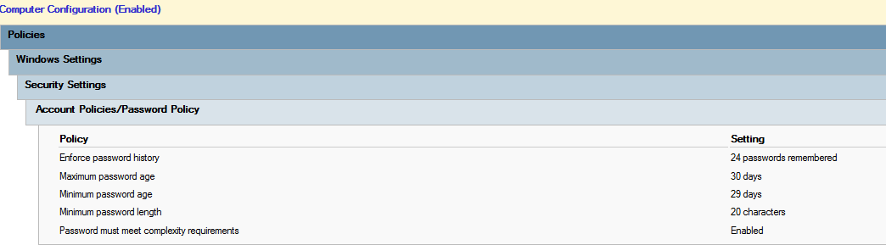
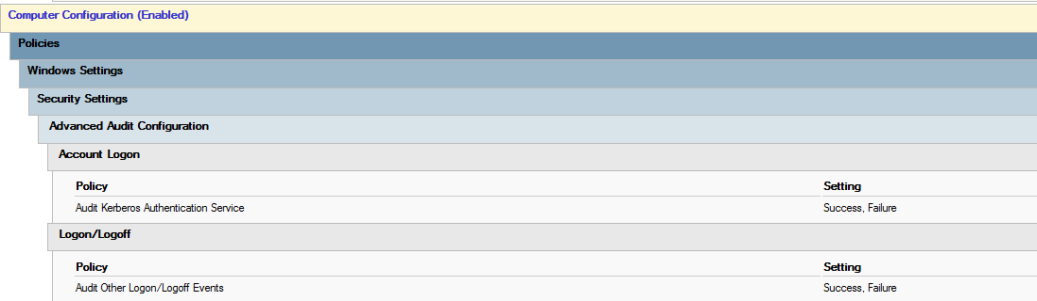
Windows Hardening

Slide 32

Recommendations
Use
Use strong authentication and long passwords (25+ characters).
Disable
Disable unused services and remove default installations.
Apply
Apply principle of least privilege for all accounts.
Enable
Enable Kerberos anomaly detection.
Monitor
Continuously monitor logs via Wazuh and Snort.
Audit
Regularly audit AD group memberships and service accounts.

Slide 33

Lessons Learned
Weak authentication and misconfigurations rapidly lead to full domain compromise.
Attackers chain multiple small vulnerabilities.
SIEM visibility (Wazuh) is critical to understanding attack sequences.
Defense-in-depth is essential for effective security.
Continuous monitoring + hardening significantly reduces attack surface

